Slide 1


VIVEKANAND EDUCATION SOCIETY’S INSTITUTE OF TECHNOLOGY
FLUTTER Presentation
Advisor
Student
FLUTTER
Dr. Ravita Mishra
Aniket Mahajan
D15B 33

Slide 2
VIVEKANAND EDUCATION SOCIETY’S INSTITUTE OF TECHNOLOGY
Table of Contents
I
Introduction and Motivation
II
Objectives
III
Implementation
IV
Feasibility Analysis
V
Risk Analysis
VI
Literature Survey
VII
Conclusion and Discussion
VIII
References
2
2

Slide 3

I
INTRODUCTION AND MOTIVATION
In today's fast-paced world, the need for meaningful connections and partnerships is more critical than ever. Startups are constantly seeking resources and support to thrive, while investors are eager to identify promising ventures to fuel their portfolios. Similarly, NGOs are continuously striving to make a positive impact on society, relying on partnerships and funding to drive their initiatives forward.
Introducing Portal: Facilitating Connections Between Startups, Investors, and NGOs
Portal is a straightforward yet powerful platform designed to connect startups, investors, and NGOs seamlessly. Our platform simplifies the process of networking, collaboration, and information sharing, enabling users to discover exciting opportunities and forge meaningful connections within the entrepreneurial ecosystem.
3
2

Slide 4
Problem Statement
Startups lack efficient channels to connect with investors, hindering their access to crucial funding and support. Conversely, investors struggle to identify viable investment opportunities amidst a cluttered landscape. Current platforms often lack transparency and effective matchmaking, leading to missed connections and inefficiencies. Additionally, NGOs face challenges in raising funds and securing partnerships due to limited visibility and access. There's a pressing need for a solution that streamlines communication, fosters connections, and empowers stakeholders to drive innovation and social impact effectively.
4

Slide 5

II
OBJECTIVES
Facilitate Connections: Create a user-friendly platform that simplifies the process of connecting startup founders with investors, enabling them to discover mutually beneficial opportunities.
Empower Startups: Provide startups with access to a diverse network of investors, allowing them to showcase their ideas, pitch their ventures, and secure the funding needed to fuel their growth and success.
Empower Investors: Offer investors a curated selection of promising startup ventures, providing them with opportunities to identify and invest in high-potential ventures aligned with their investment criteria and objectives.
Promote Collaboration: Foster a collaborative ecosystem where startup founders and investors can interact, exchange insights, and forge meaningful partnerships that drive innovation and create value.
Promote Social Impact: At Portal, we are committed to promoting social impact and sustainability. Through our platform, we aim to connect NGOs with resources, funding, and partnerships to amplify their impact and drive positive change in society.
5
2

Slide 6
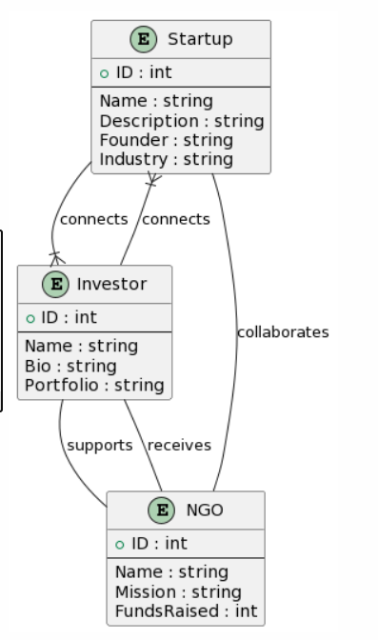
ER Diagram of Proposed System
6

Slide 7
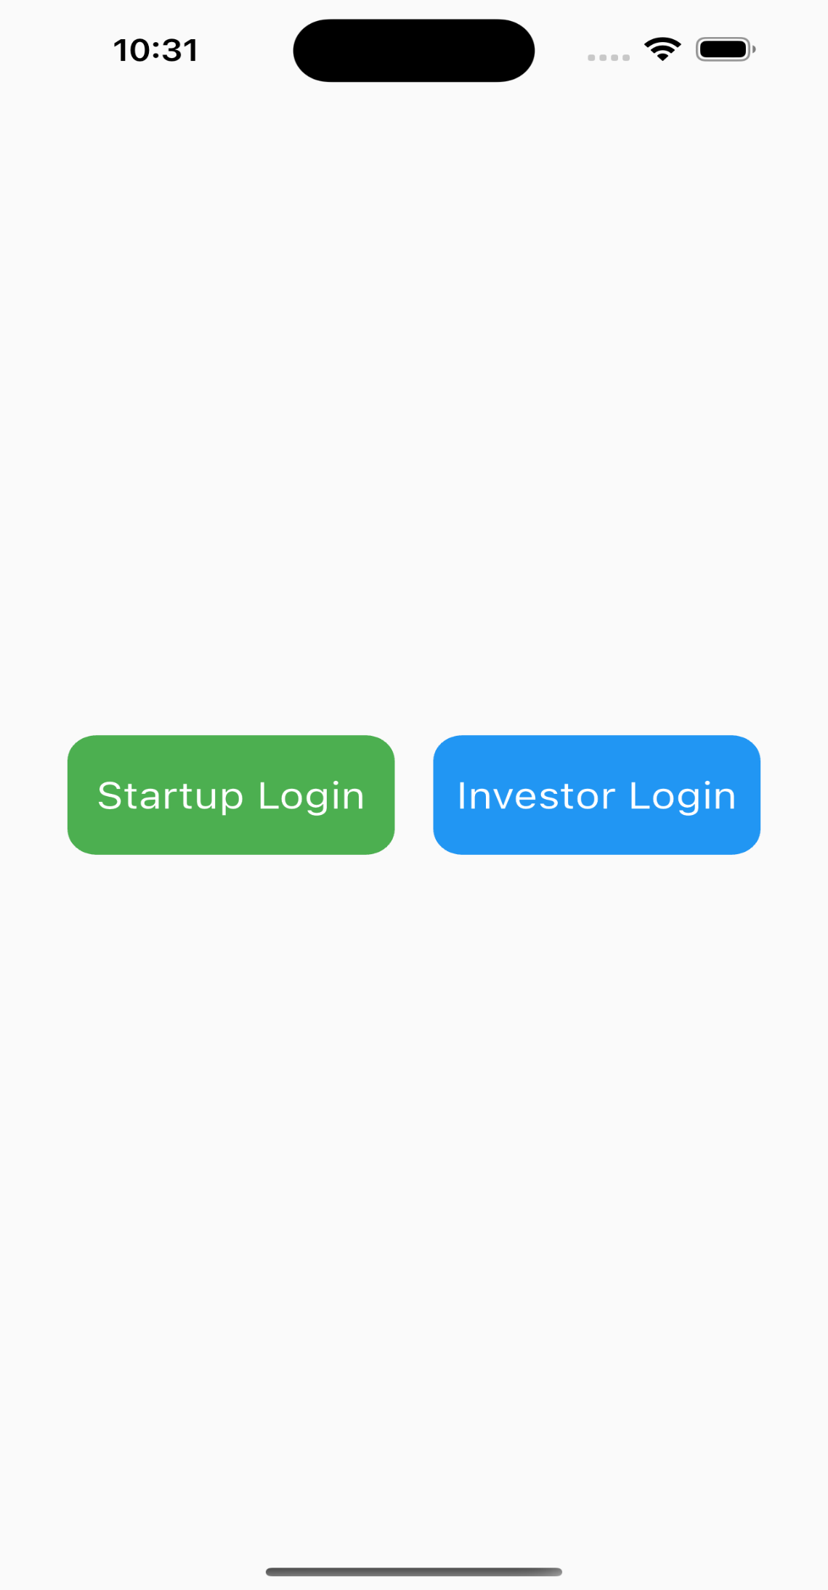
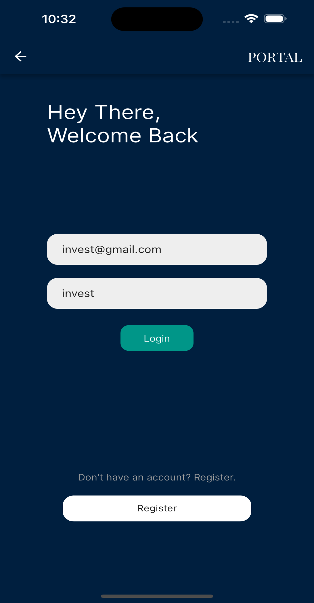
III
IMPLEMENTATION
a. Login Page (for both startup and investors)
7

Slide 8
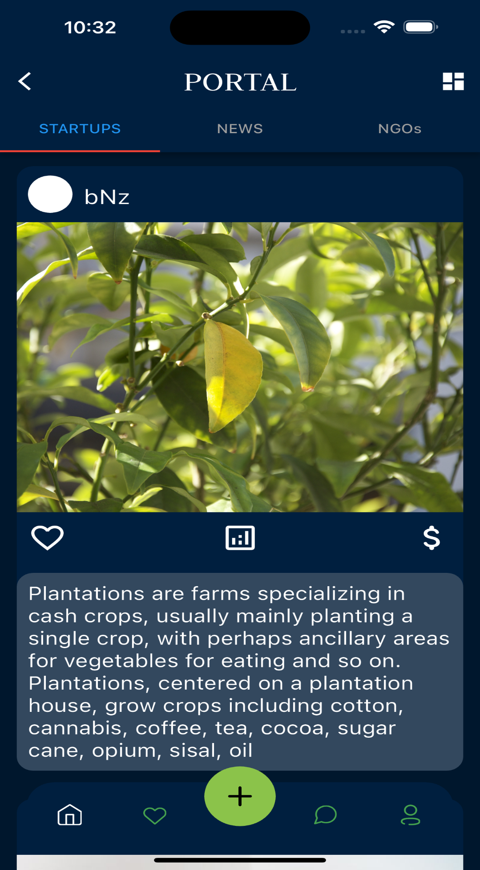
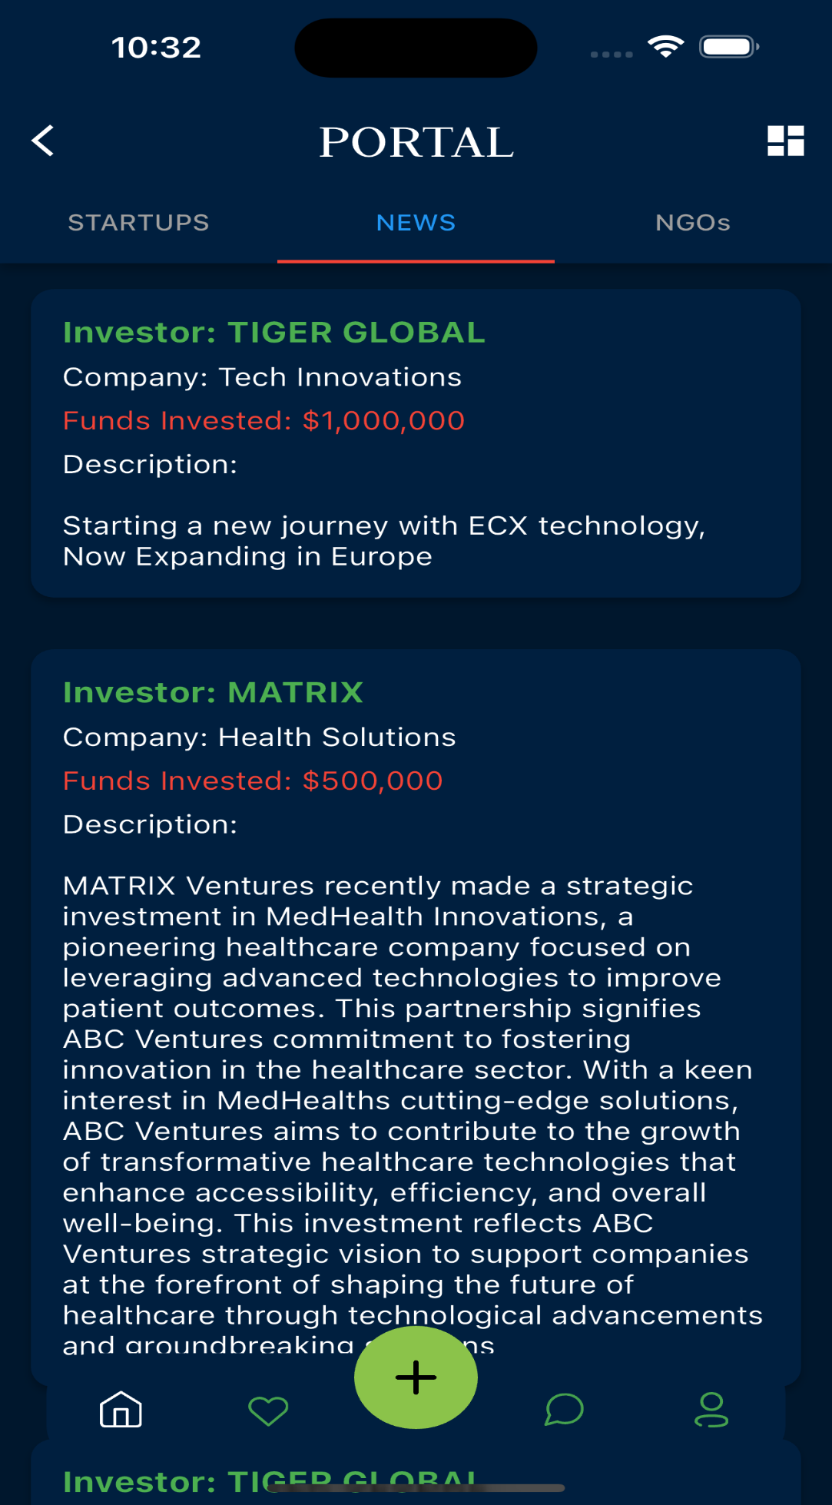
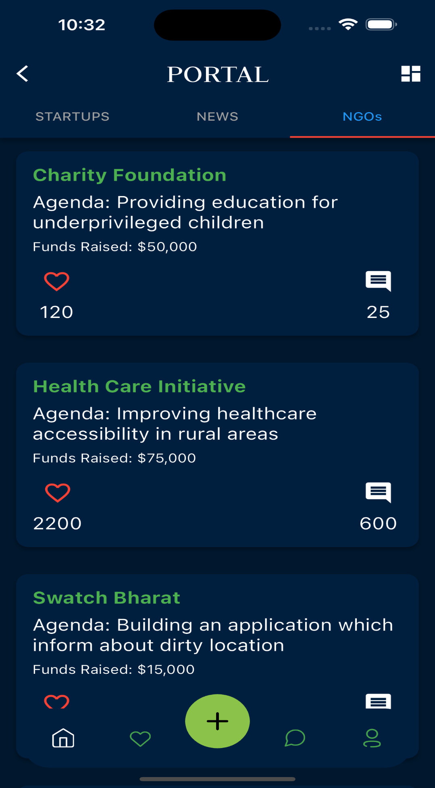
III
IMPLEMENTATION
b. Dashboard
Investors
8

Slide 9
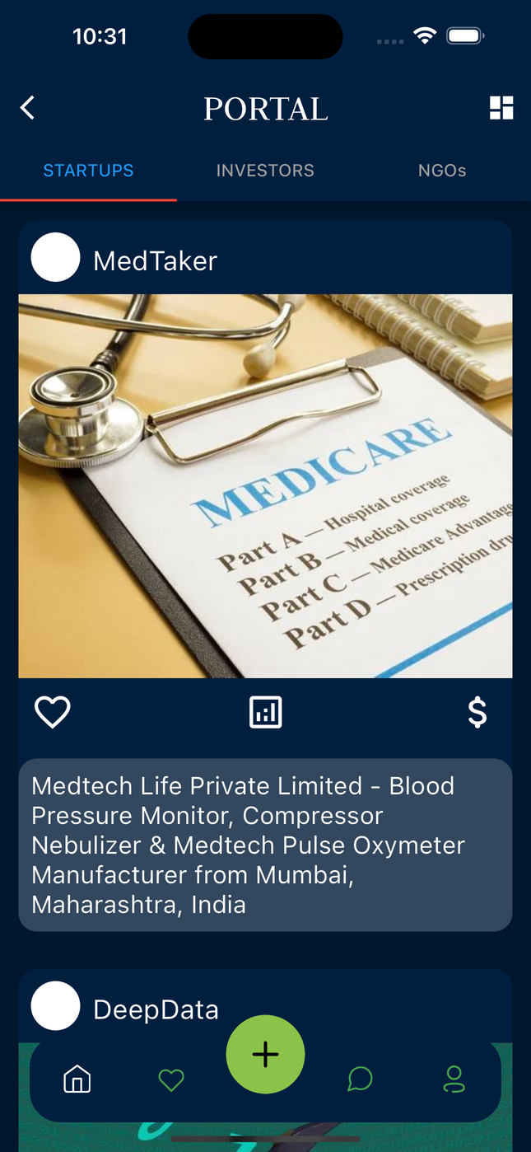
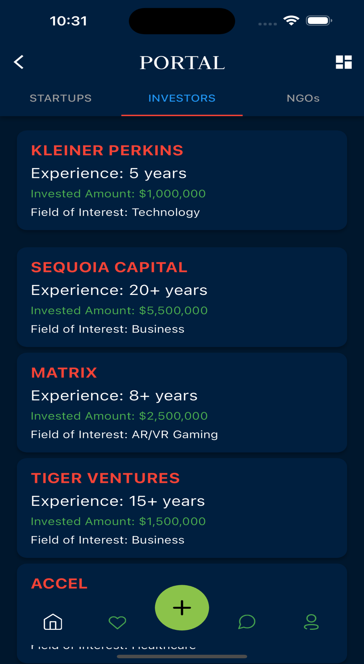
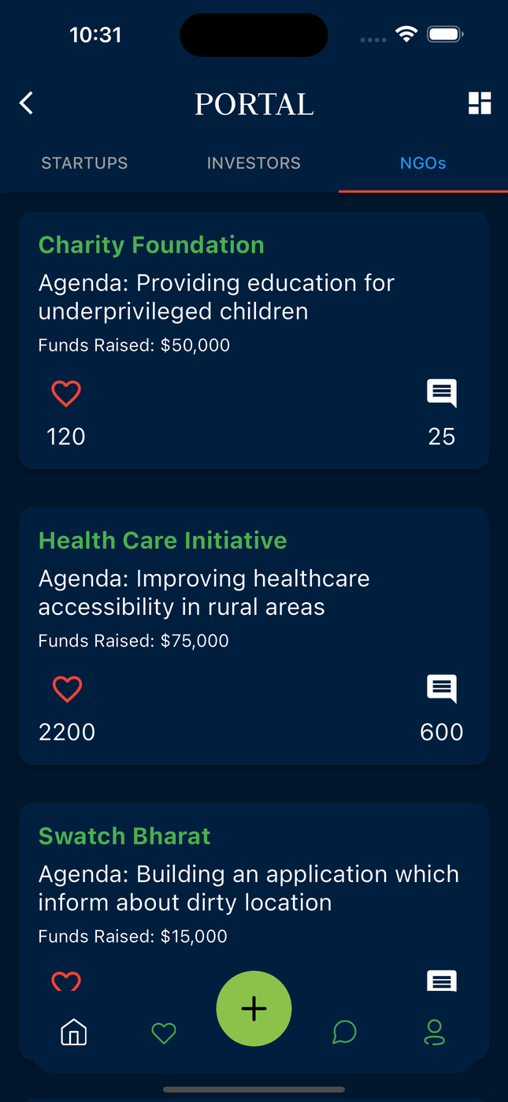
III
IMPLEMENTATION
Startups
9

Slide 10

IV
FEASIBILITY ANALYSIS
Technical Feasibility: Leveraging Flutter, a robust and cross-platform framework, ensures compatibility with both Android and iOS devices, reducing development time and maintenance efforts.
Market Feasibility: The growing demand for platforms facilitating startup-investor-NGO collaborations signifies a lucrative market opportunity, with potential for significant user acquisition and revenue generation.
Financial Feasibility: With Flutter's cost-effective development model and open-source nature, development expenses are minimized while maintaining high-quality app performance, making it financially viable.
10
2

Slide 11

V
RISK ANALYSIS
Technical Risks: Potential technical challenges such as compatibility issues with certain devices or operating system versions could affect user experience and app performance, necessitating thorough testing and debugging processes.
Market Risks: Fluctuations in market demand or shifts in user preferences may impact user acquisition and retention rates, requiring continuous market monitoring and adaptation of the app's features and offerings.
Operational Risks: Operational disruptions such as server outages or software bugs could hinder app functionality and user engagement, emphasizing the importance of robust infrastructure and proactive maintenance protocols.
11
2

Slide 12


VI
LITERATURE SURVEY
TOPIC
AUTHOR
\
Flutter in Action
The Pragmatic Programmer
Programming Flutter: Native, CrossPlatform Apps the Easy Way
RESTful API Design: Best Practices in API Design with REST
Continuous Integration: Improving Software Quality and Reducing Risk
Eric Windmill
Andrew Hunt and David Thomas
Carmine Zaccagnino
Matthias Biehl
Paul M. Duvall
12
2

Slide 13
VII
CONCLUSION & DISCUSSIONS
In conclusion, Portal stands as a promising solution for connecting startups, investors, and NGOs on a single platform. Leveraging the power of Flutter, Portal offers a user-friendly interface, seamless cross-platform compatibility, and efficient performance.
Portal has the potential to drive innovation, facilitate social impact, and empower stakeholders within the entrepreneurial ecosystem. As we embark on this journey, we are dedicated to continuously enhancing Portal's capabilities
13
2

Slide 14

Journals like ACM Digital Library, IEEE Xplore, and Google Scholar provide perreviewed journals in areas related to mobile app development, news aggregation, user experience, and information technology.
VIII
REFERENCES
Refer to official documentation and guidelines provided by platforms such as Flutter, Google Play Store, and Apple App Store for information on app development best practices, security guidelines, and compliance requirements.
Websites like Coursera, Udemy, and LinkedIn Learning offer courses and tutorials on app development, user experience design, cybersecurity, and digital marketing provided valuable practical knowledge and skills relevant to our project.
14
2

Slide 15
VIVEKANAND EDUCATION SOCIETY’S INSTITUTE OF TECHNOLOGY
Thank you
for listening!
Advisor
Student
Dr. Ravita Mishra
Aniket Mahajan
15

Slide 16
E-Commerce PWA
Aniket Mahajan
D15B 33
D

Slide 17
What is PWA?
PWA stands for Progressive Web App. It's a type of application software delivered through the web, built using common web technologies like HTML, CSS, and JavaScript. PWAs are designed to work on any platform that uses a standards-compliant browser, including both desktop and mobile devices.
2

Slide 18
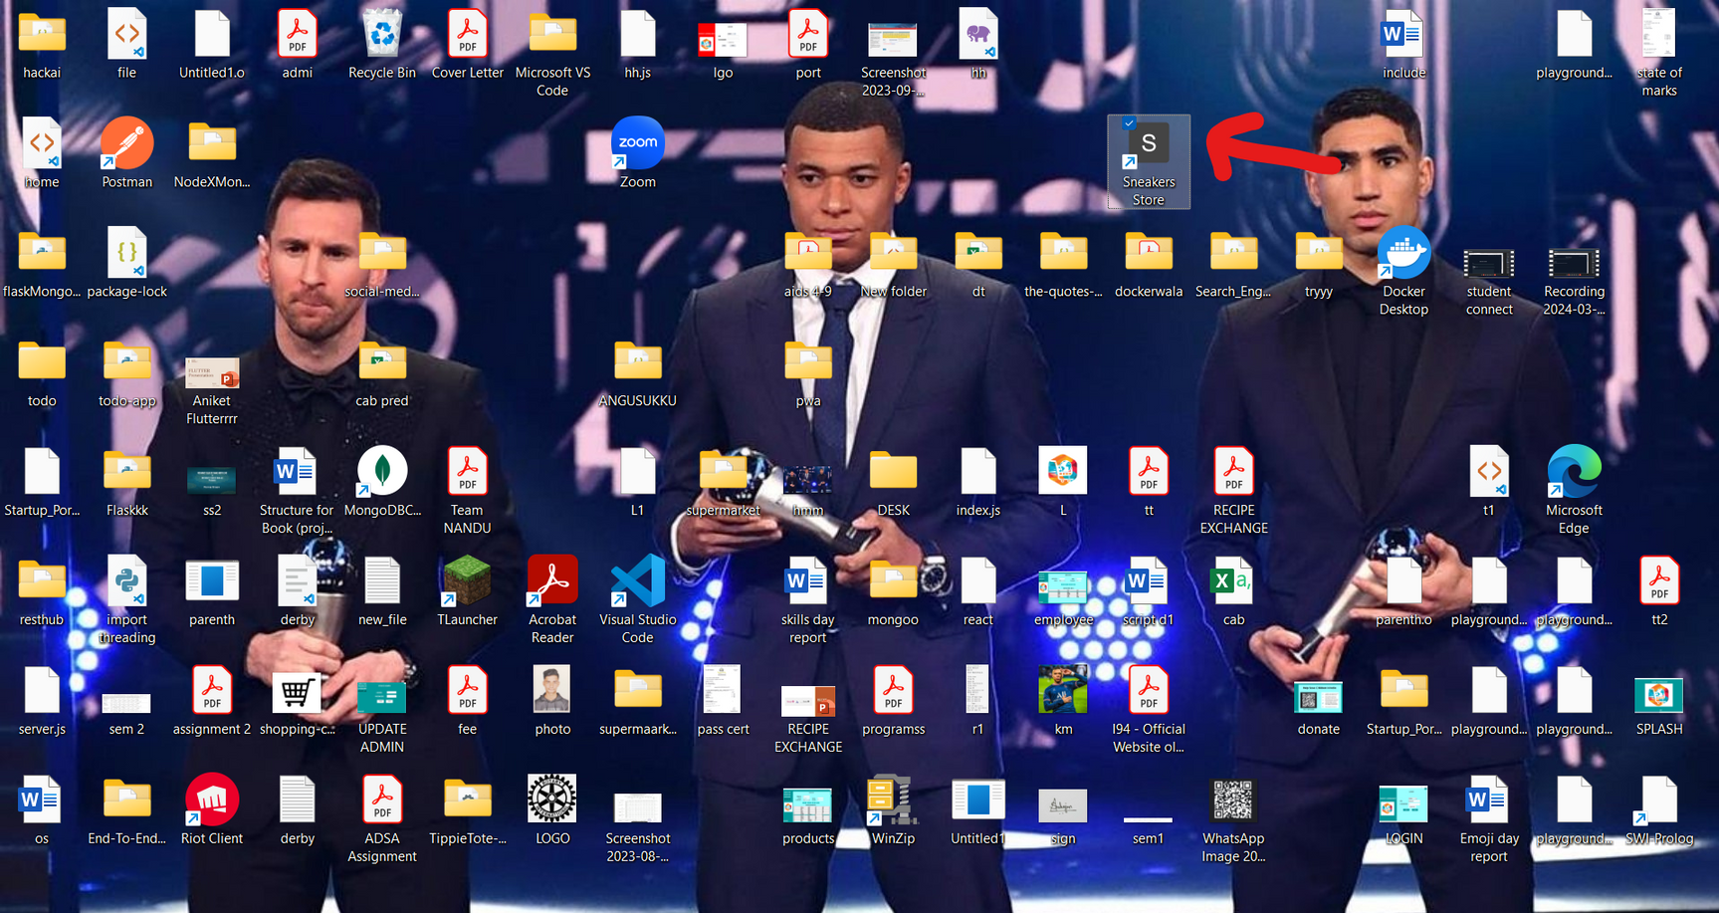
Installation of PWA
3

Slide 19
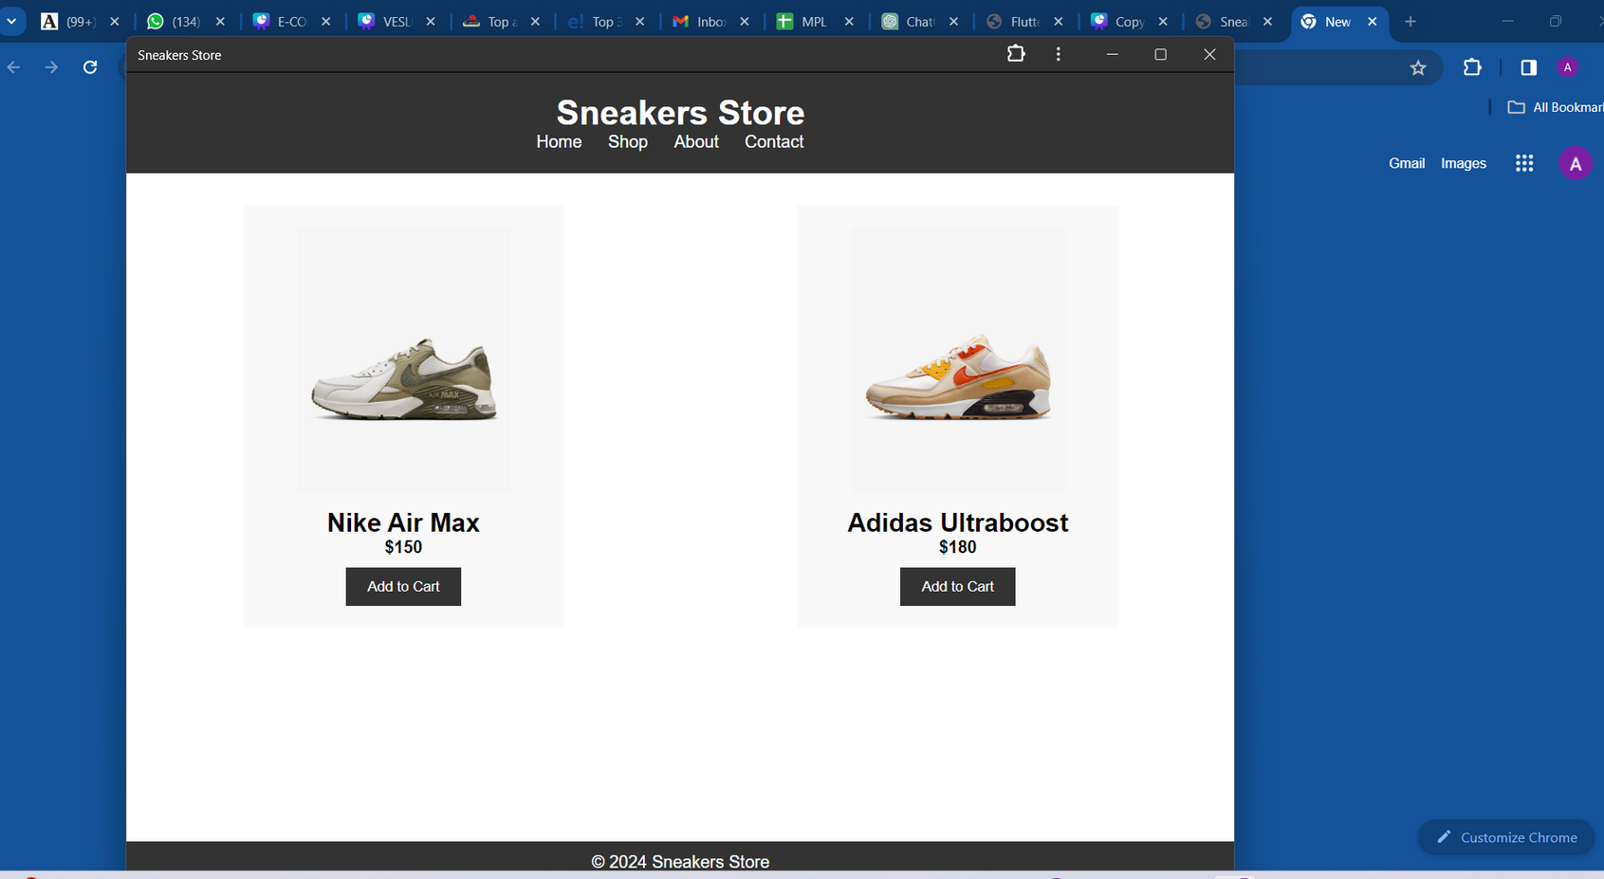
Installation of PWA
4

Slide 20
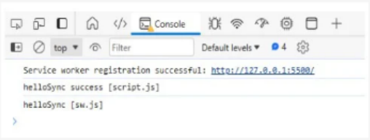
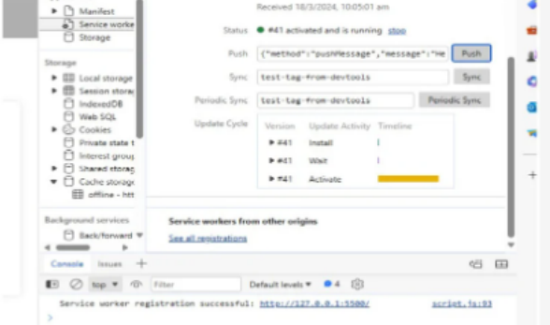
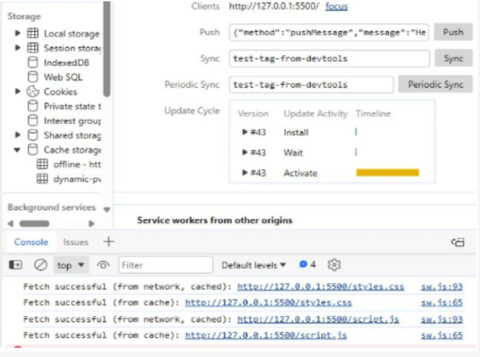
PWA FEATURES-
Fetch, Sync and Push
Sync
Push
Fetch
5

Slide 21
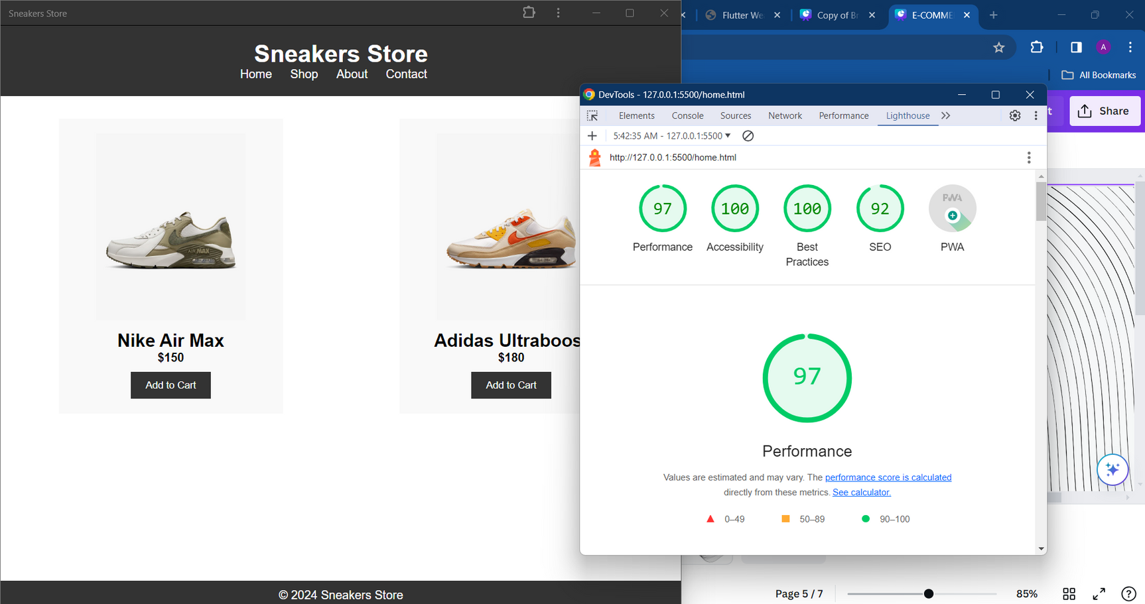
Performance Analysis with Google Lighthouse
Utilize Google Lighthouse for comprehensive website auditing, providing insights into performance, accessibility, best practices, and SEO.
Leverage Google Lighthouse to assess and optimize the skincare eCommerce site for improved performance, accessibility, and search engine visibility.
6

Slide 22
Conclusion
In conclusion, our journey in building the E-commerce Progressive Web Application (PWA) has been marked by significant achievements. From the successful installation and service worker registration to the seamless implementation of fetch, push, and sync events, followed by deployment and thorough performance analysis using Google Lighthouse, we have demonstrated the power and versatility of PWAs in modern web development.
7

